Slide 1
PJM Wholesale Markets 2030
Stu Bresler
Senior Vice President – Operations and Markets
PJM Interconnection

Slide 2
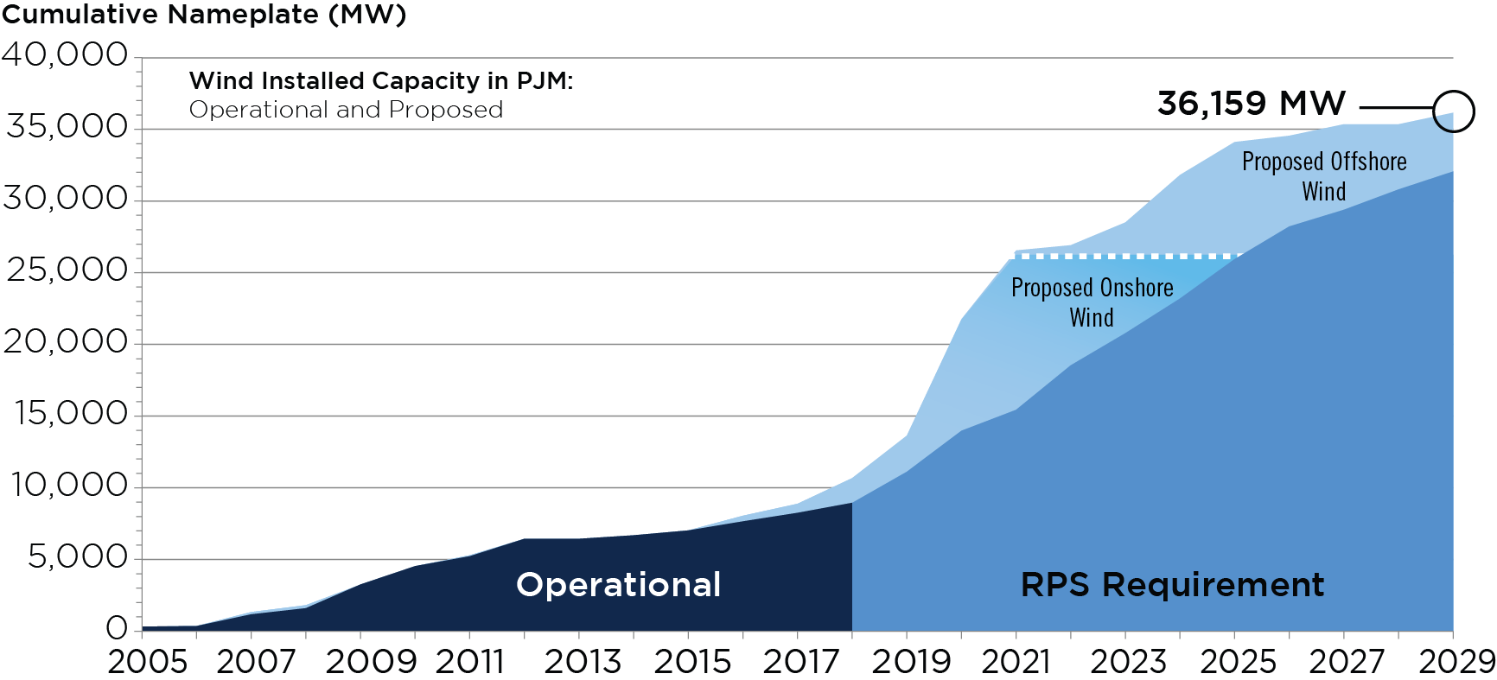
2018 Wind Capacity in PJM Generation is Stated in MWh
Notes:
Schuyler updated 1/18/2019

Slide 3
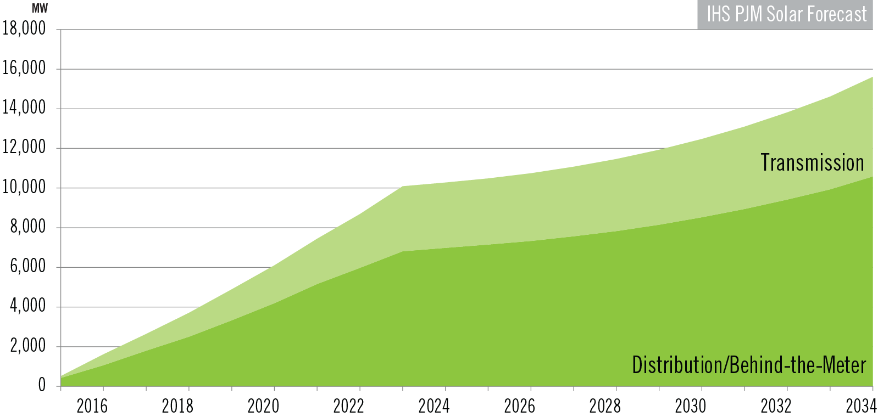
Solar Forecast
Notes:
Mooney 3/4/2019

Slide 4
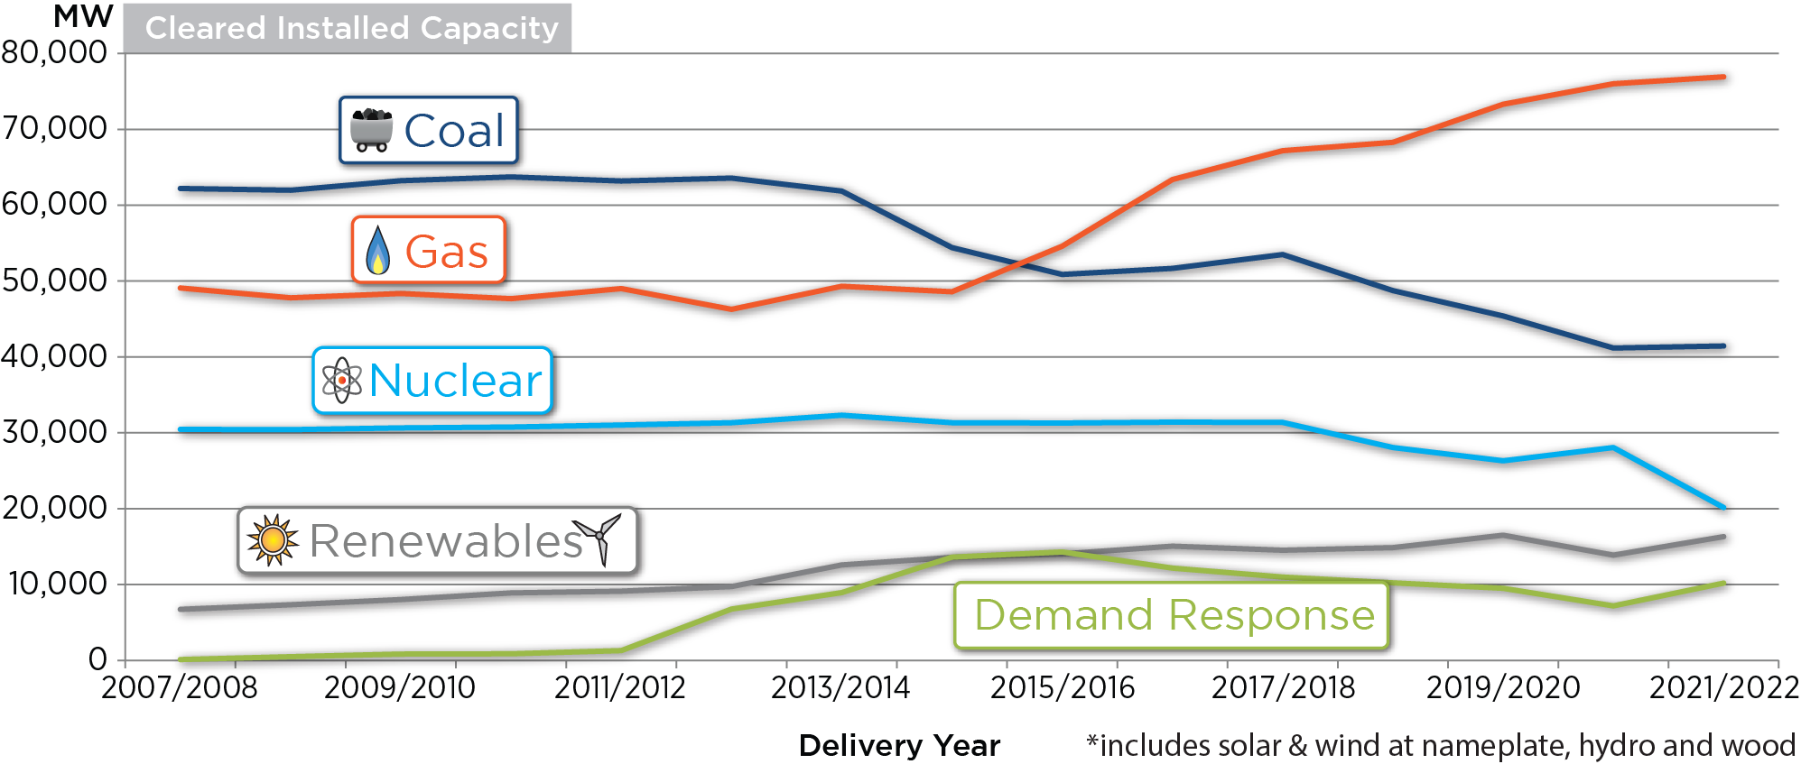
Cleared Installed Capacity
Notes:
Bastian/Helm RPM results
6/19/2018

Slide 5
Future of Energy Markets
Advanced Technologies
Fuel Neutral Approach
System Flexibility Needs

Slide 6
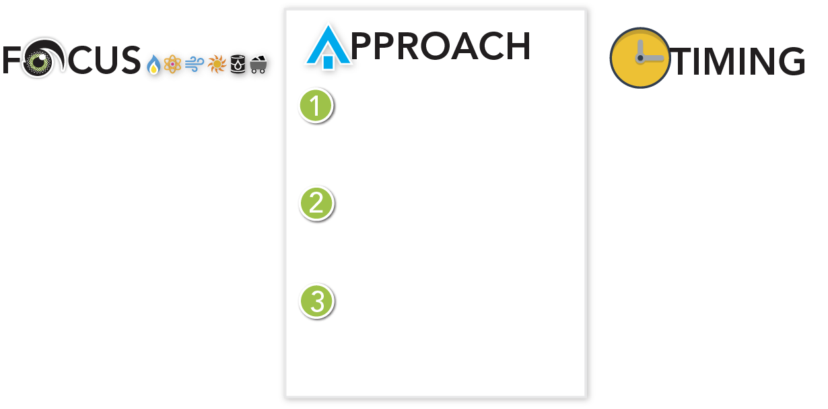
Assuring Fuel Security for the Future
Define fuel security considering risks in fuel delivery to critical generators
Reaffirm the value of markets to achieving a cost-effective, fuel-secure fleet of resources
Identify fuel security risks with a primary focus on resilience
Establish criteria to value fuel security in PJM markets
Phase 1: Analysis Identify potential system vulnerabilities and develop criteria to address them
May–November 2018
Analysis
May 2018 – December 2019
Phase 3 ongoing coordination
2019/2020
Phase 2 - Assess market design in 2019 and target solution filed with FERC early 2020
Phase 2: Modeling Model incorporation of vulnerabilities into PJM’s markets
Phase 3: Ongoing Coordination
Address specific security concerns identified by federal and state agencies
Notes:
Dave Souder

Slide 7
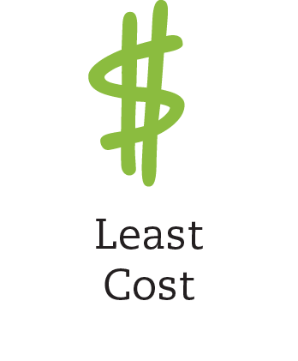
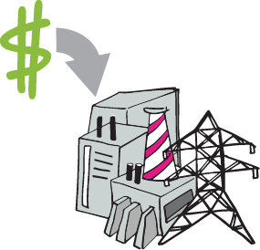
Is the Goal of Markets Changing . . .
From Reliability at
Other public policy goals?
To:
Notes:
State Portfolios
Carbon
Subsidies
Renewables

Slide 8
PJM Carbon Pricing Study
Carbon Pricing Scheme | Carbon Adder | Border Adjustment | Base Natural Gas Prices & Load Forecast | Natural Gas Sensitivities |  | Load Forecast Sensitivities
 |  |  |  | Low | High | Low | High
Reference* | None | None | 1 | 14 | 27 | 40 | 53
Regional | SCC – 25% | External Only | 2 | 15 | 28 | 41 | 54
 | Social Cost of Carbon (SCC) ** |  | 3 | 16 | 29 | 42 | 55
 | SCC + 25% |  | 4 | 17 | 30 | 43 | 56
Sub-Regional | SCC – 25% | External Only | 5 | 18 | 31 | 44 | 57
 |  | One-Way | 6 | 19 | 32 | 45 | 58
 |  | Two-Way | 7 | 20 | 33 | 46 | 59
 | Social Cost of Carbon (SCC) | External Only | 8 | 21 | 34 | 47 | 60
 |  | One-Way | 9 | 22 | 35 | 48 | 61
 |  | Two-Way | 10 | 23 | 36 | 49 | 62
 | SCC + 25% | External Only | 11 | 24 | 37 | 50 | 63
 |  | One-Way | 12 | 25 | 38 | 51 | 64
 |  | Two-Way | 13 | 26 | 39 | 52 | 65
* Will include RGGI
** 2023 Social Cost of Carbon = $52.79

Slide 9
The Future of DER
Notes:
Flexibility Procurement
Grid Access & Generation Management
Data exchange between TSO & parties connected to the transport grid
Mutual exchange of operational & contractual data

